Slide 1
Outline
Introduction
What is a distributed DBMS
Distributed DBMS Architecture
Background
Distributed Database Design
Database Integration
Semantic Data Control
Distributed Query Processing
Multidatabase query processing
Distributed Transaction Management
Data Replication
Parallel Database Systems
Distributed Object DBMS
Peer-to-Peer Data Management
Web Data Management
Current Issues

Slide 2
File Systems
program 1
File 1
data description 1
program 2
data description 2
File 2
program 3
data description 3
File 3

Slide 3
Database Management
Application
program 1
(with data
semantics)
DBMS
description
Application
program 2
(with data
semantics)
manipulation
database
control
Application
program 3
(with data
semantics)

Slide 4
Motivation
Database
Technology
Computer
Networks
integration
distribution
Distributed
Database
Systems
integration
integration ≠ centralization

Slide 5
Distributed Computing
A number of autonomous processing elements (not necessarily homogeneous) that are interconnected by a computer network and that cooperate in performing their assigned tasks.
What is being distributed?
Processing logic
Function
Data
Control

Slide 6
What is a Distributed Database System?
A distributed database (DDB) is a collection of multiple, logically interrelated databases distributed over a computer network.
A distributed database management system (D–DBMS) is the software that manages the DDB and provides an access mechanism that makes this distribution transparent to the users.
Distributed database system (DDBS) = DDB + D–DBMS

Slide 7
What is not a DDBS?
A timesharing computer system
A loosely or tightly coupled multiprocessor system
A database system which resides at one of the nodes of a network of computers - this is a centralized database on a network node

Slide 8
Centralized DBMS on a Network
Site 1
Site 2
Site 5
Communication
Network
Site 4
Site 3

Slide 9
Distributed DBMS Environment
Site 1
Site 2
Site 5
Communication
Network
Site 4
Site 3

Slide 10
Implicit Assumptions
Data stored at a number of sites 🡪 each site logically consists of a single processor.
Processors at different sites are interconnected by a computer network 🡪 not a multiprocessor system
Parallel database systems
Distributed database is a database, not a collection of files 🡪 data logically related as exhibited in the users’ access patterns
Relational data model
D-DBMS is a full-fledged DBMS
Not remote file system, not a TP system

Slide 11
Data Delivery Alternatives
Delivery modes
Pull-only
Push-only
Hybrid
Frequency
Periodic
Conditional
Ad-hoc or irregular
Communication Methods
Unicast
One-to-many
Note: not all combinations make sense

Slide 12
Distributed DBMS Promises
Transparent management of distributed, fragmented, and replicated data
Improved reliability/availability through distributed transactions
Improved performance
Easier and more economical system expansion

Slide 13
Transparency
Transparency is the separation of the higher level semantics of a system from the lower level implementation issues.
Fundamental issue is to provide
data independence
in the distributed environment
Network (distribution) transparency
Replication transparency
Fragmentation transparency
horizontal fragmentation: selection
vertical fragmentation: projection
hybrid

Slide 14
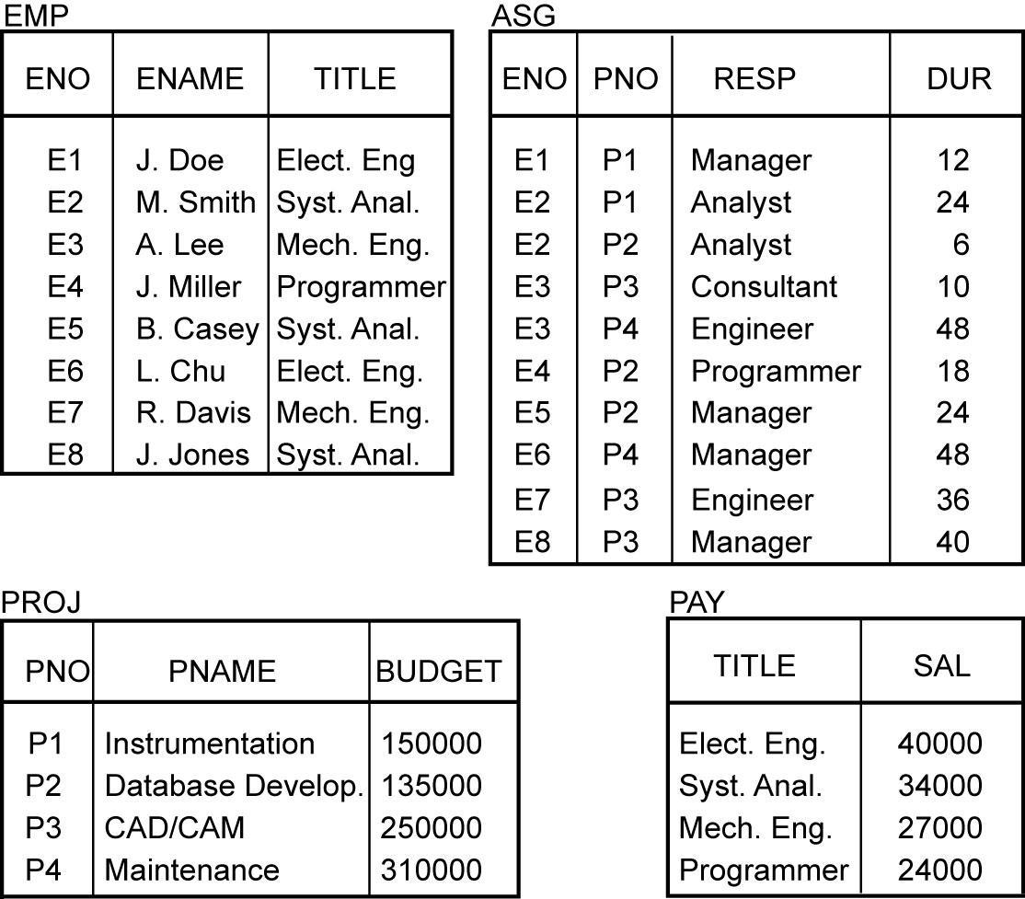
Example

Slide 15
Transparent Access
SELECT ENAME,SAL
FROM EMP,ASG,PAY
WHERE DUR > 12
AND EMP.ENO = ASG.ENO
AND PAY.TITLE = EMP.TITLE
Tokyo
Boston
Paris
Paris projects
Paris employees
Paris assignments
Boston employees
Communication
Network
Boston projects
Boston employees
Boston assignments
Montreal
New
York
Montreal projects
Paris projects
New York projects
with budget > 200000
Montreal employees
Montreal assignments
Boston projects
New York employees
New York projects
New York assignments
Notes:
Animated slide

Slide 16
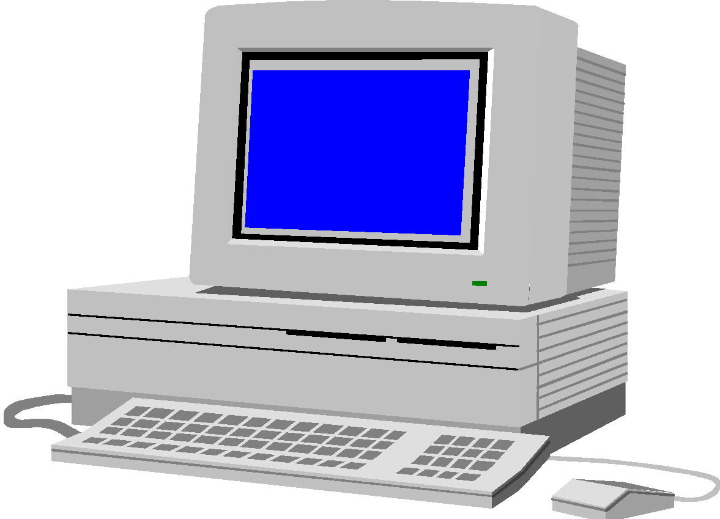
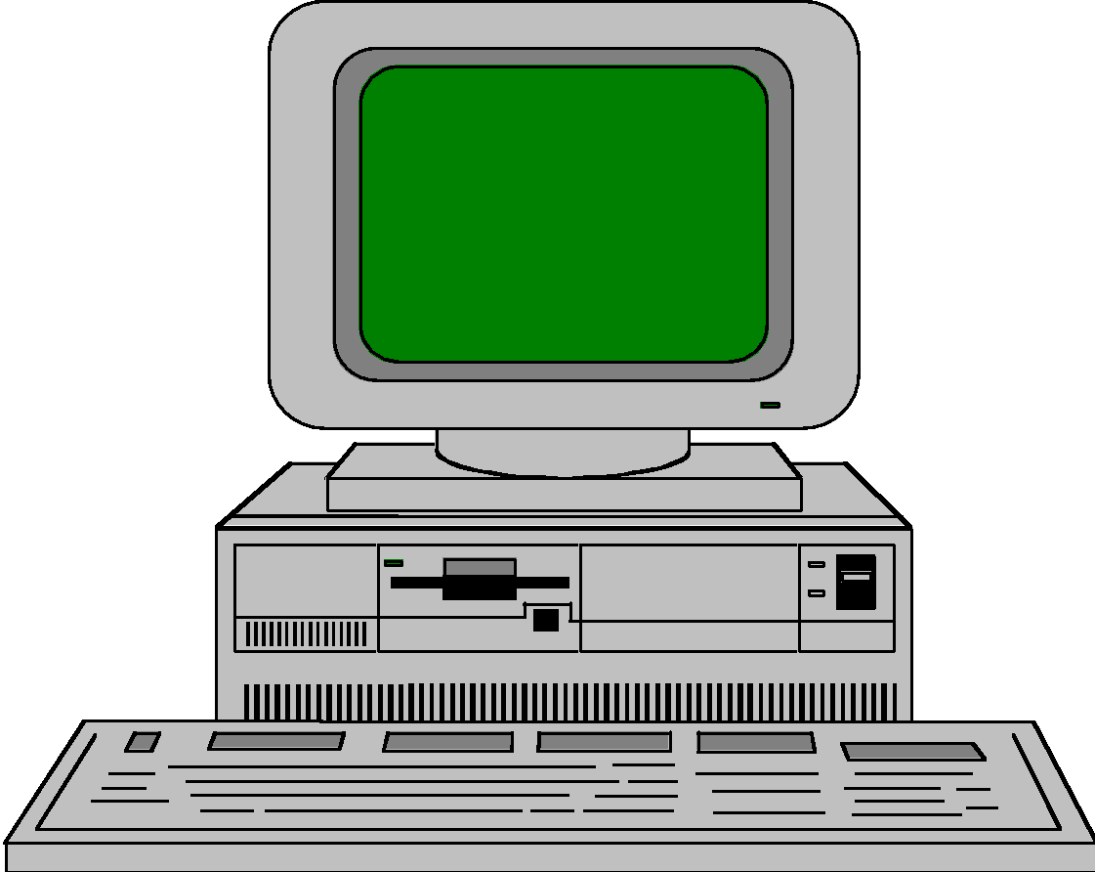
Distributed Database - User View
Distributed Database

Slide 17
Distributed DBMS - Reality
User
Query
DBMS
Software
User
Application
DBMS
Software
DBMS
Software
Communication
Subsystem
User
Application
DBMS
Software
User
Query
DBMS
Software
User
Query

Slide 18
Types of Transparency
Data independence
Network transparency (or distribution transparency)
Location transparency
Fragmentation transparency
Replication transparency
Fragmentation transparency

Slide 19
Reliability Through Transactions
Replicated components and data should make distributed DBMS more reliable.
Distributed transactions provide
Concurrency transparency
Failure atomicity
Distributed transaction support requires implementation of
Distributed concurrency control protocols
Commit protocols
Data replication
Great for read-intensive workloads, problematic for updates
Replication protocols

Slide 20
Potentially Improved Performance
Proximity of data to its points of use
Requires some support for fragmentation and replication
Parallelism in execution
Inter-query parallelism
Intra-query parallelism

Slide 21
Parallelism Requirements
Have as much of the data required by each application at the site where the application executes
Full replication
How about updates?
Mutual consistency
Freshness of copies

Slide 22
System Expansion
Issue is database scaling
Emergence of microprocessor and workstation technologies
Demise of Grosh's law
Client-server model of computing
Data communication cost vs telecommunication cost

Slide 23
Distributed DBMS Issues
Distributed Database Design
How to distribute the database
Replicated & non-replicated database distribution
A related problem in directory management
Query Processing
Convert user transactions to data manipulation instructions
Optimization problem
min{cost = data transmission + local processing}
General formulation is NP-hard

Slide 24
Distributed DBMS Issues
Concurrency Control
Synchronization of concurrent accesses
Consistency and isolation of transactions' effects
Deadlock management
Reliability
How to make the system resilient to failures
Atomicity and durability

Slide 25
Relationship Between Issues
Directory
Management
Query
Processing
Distribution
Design
Reliability
Concurrency
Control
Deadlock
Management

Slide 26
Related Issues
Operating System Support
Operating system with proper support for database operations
Dichotomy between general purpose processing requirements and database processing requirements
Open Systems and Interoperability
Distributed Multidatabase Systems
More probable scenario
Parallel issues

Slide 27
Architecture
Defines the structure of the system
components identified
functions of each component defined
interrelationships and interactions between components defined

Slide 28
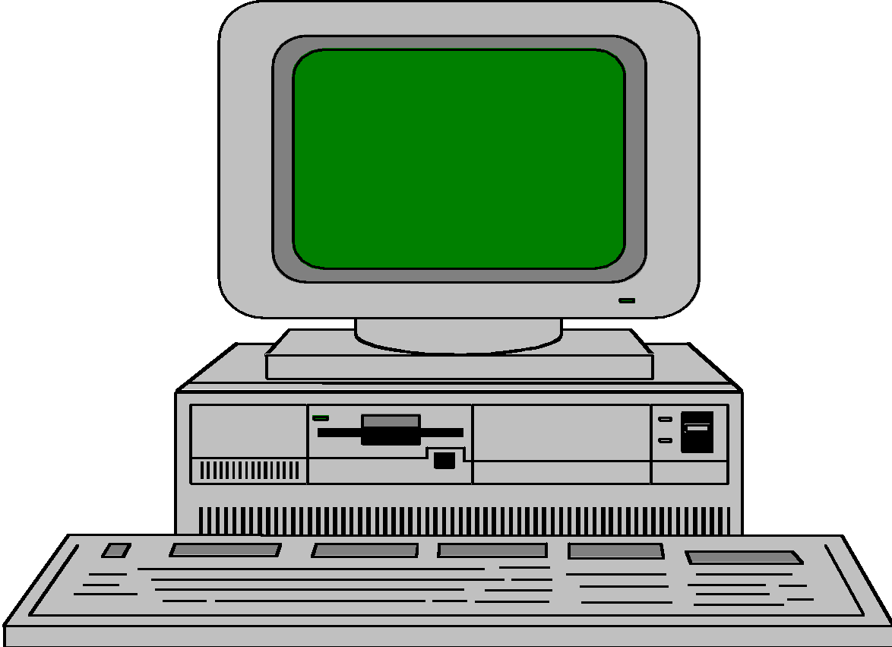



ANSI/SPARC Architecture
Users
External
Schema
External
view
External
view
External
view
Conceptual
Schema
Conceptual
view
Internal
Schema
Internal view

Slide 29
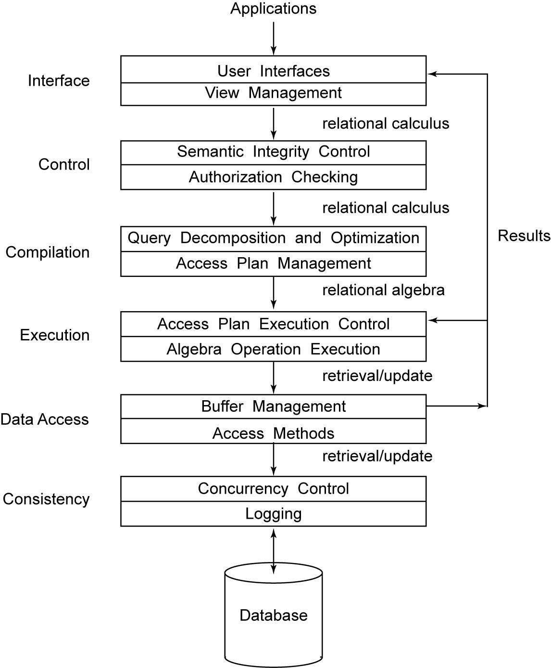
Generic DBMS Architecture

Slide 30
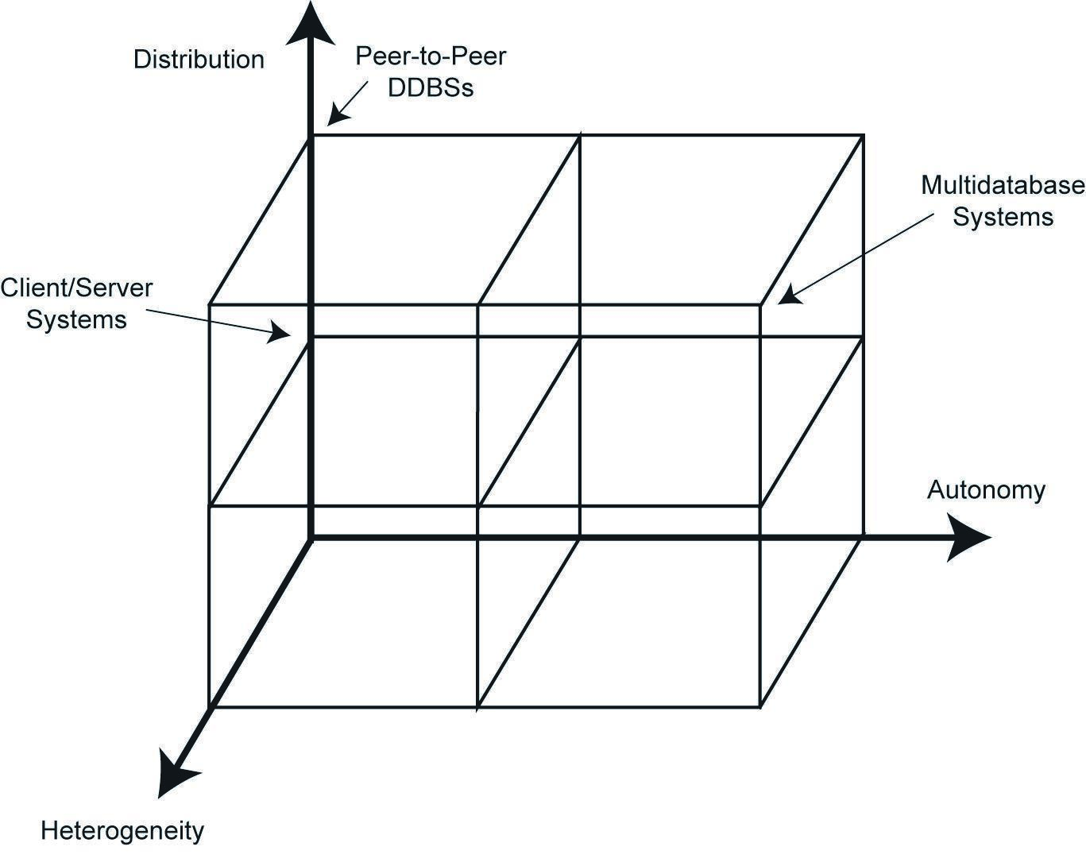
DBMS Implementation Alternatives

Slide 31
Dimensions of the Problem
Distribution
Whether the components of the system are located on the same machine or not
Heterogeneity
Various levels (hardware, communications, operating system)
DBMS important one
data model, query language,transaction management algorithms
Autonomy
Not well understood and most troublesome
Various versions
Design autonomy: Ability of a component DBMS to decide on issues related to its own design.
Communication autonomy: Ability of a component DBMS to decide whether and how to communicate with other DBMSs.
Execution autonomy: Ability of a component DBMS to execute local operations in any manner it wants to.

Slide 32
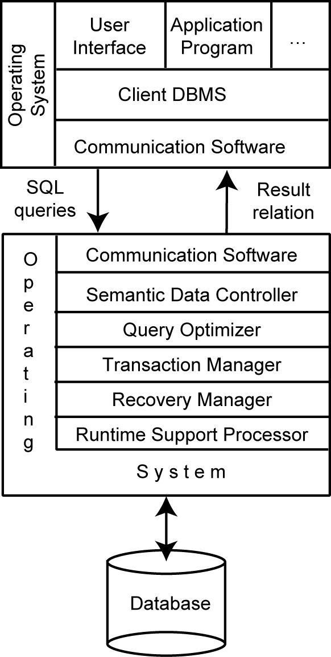
Client/Server Architecture

Slide 33
Advantages of Client-Server Architectures
More efficient division of labor
Horizontal and vertical scaling of resources
Better price/performance on client machines
Ability to use familiar tools on client machines
Client access to remote data (via standards)
Full DBMS functionality provided to client workstations
Overall better system price/performance

Slide 34
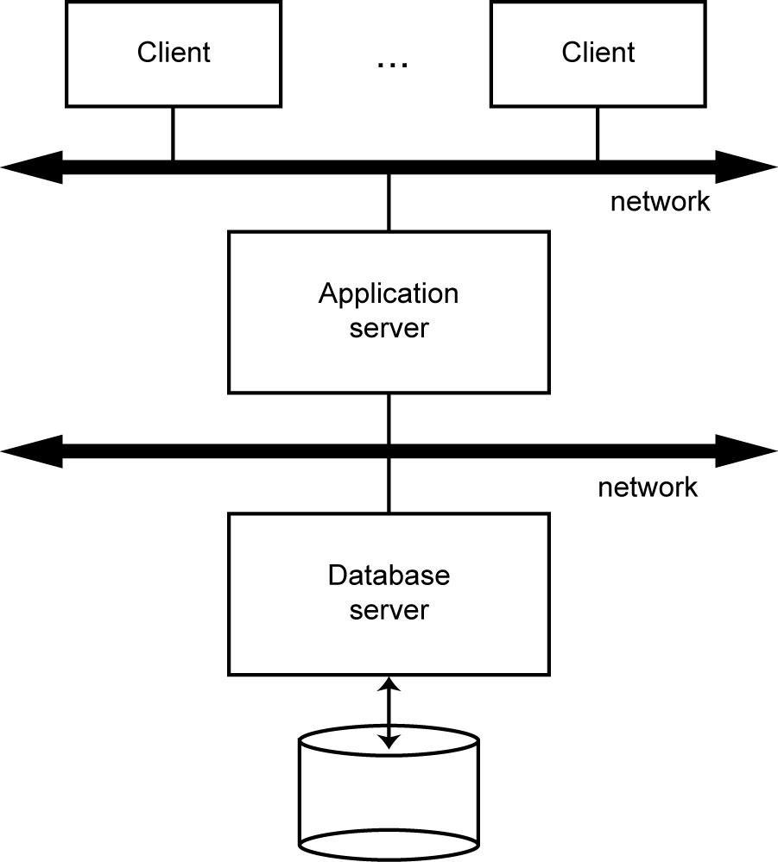
Database Server

Slide 35
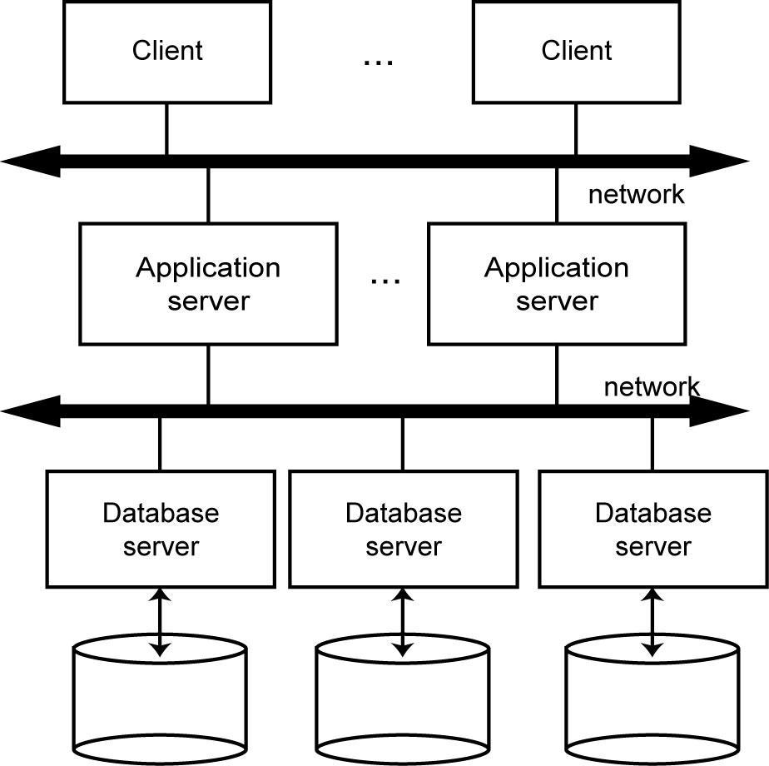
Distributed Database Servers

Slide 36
Datalogical Distributed DBMS Architecture
...
ES₁
ES₂
ES_{n}
GCS
...
LCS₁
LCS₂
LCS_{n}
...
LIS₁
LIS₂
LIS_{n}

Slide 37
Peer-to-Peer Component Architecture
USER PROCESSOR
DATA PROCESSOR
External
Schema
Global
Conceptual
Schema
Local
Conceptual
Schema
System
Log
Local
Internal
Schema
GD/D
User
requests
Database
User Interface
Handler
Semantic Data
Controller
Global Query
Optimizer
Global
Execution
Monitor
Local Query
Processor
Local Recovery
Manager
Runtime
Support
Processor
USER
System
responses

Slide 38
Datalogical Multi-DBMS Architecture
...
GES₁
GES₂
GES_{n}
…
…
LES₁₁
LES_{1n}
GCS
LES_{n1}
LES_{nm}
…
LCS₁
LCS₂
LCS_{n}
…
LIS₁
LIS₂
LIS_{n}

Slide 39
MDBS Components & Execution
Global
User
Request
Local
User
Request
Local
User
Request
Multi-DBMS
Layer
Global
Subrequest
Global
Subrequest
Global
Subrequest
DBMS₁
DBMS₂
DBMS₃

Slide 40
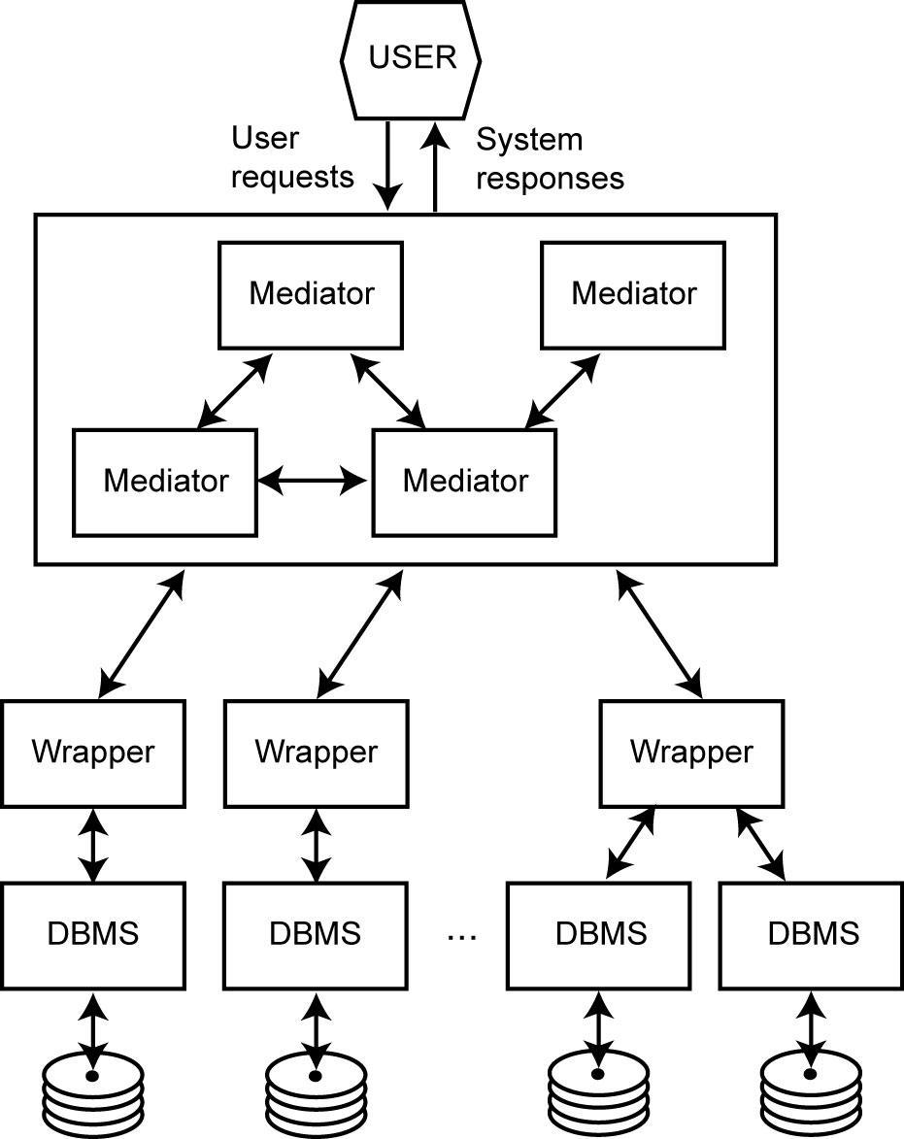
Mediator/Wrapper Architecture

